Slide 1

Pavithra 4VP24MC032
Car Damage Detection and Insurance Claim System
Prof. Anil Kumar K Assistant Professor

Slide 2
Contents
Introduction
Objectives
Literature review
Design Phase
Implementation
Results and Discussion
Conclusion
Future Enhancements
References

Slide 3
Introduction
The system provides an automated and efficient solution for vehicle damage assessment and insurance claim processing.
It uses computer vision and deep learning to detect damages like dents, scratches, and cracks from uploaded images.
The platform identifies damaged areas, estimates repair costs, and generates detailed reports for quick decision-making.
Users can register, manage profiles, view insurance plans, apply for claims, and make payments within the system.
Insurance agents can verify claims, approve estimates, and schedule payments, ensuring faster, accurate, and transparent claim processing.

Slide 4
Objectives
Detection and classification of vehicle damages using deep learning.
Generate detailed damage reports pdf with confidence scores .
Provide accurate cost estimation and efficient payment processing for the approved claims.
Make it easy to apply, track the status, and manage insurance claims.

Slide 5
Literature Review
Title | Author&Year | Description
Deep Learning based Car Damage Detection for Insurance Claim Settlement | Monas Chaubal et al.(2025) | Uses ResNet-50, EfficientNet-B0, transfer learning and ensemble learning for car damage classification. Works on TQVCD dataset identifying front/rear orientation and damage categories. Improves insurance claim automation and reduces manual inspection.
Automated Damage Detection and Repair Cost Estimation for Automobiles | Pindi Lokeswari et al.(2025) | Uses Mask R-CNN with ResNet50- FPN for car damage segmentation. Generates repair cost estimation and damage localization. Achieved 88.78% accuracy and 0.880 F1- score.
5

Slide 6
Image-Based Classification for Accident Detection and Insurance Claim using Machine Learning | Rithik M., SP Chokkalingam (2025) | Uses CNN for accident detection, U-Net for segmentation-based damage assessment, and Gradient Boosting Machine (GBM) for insurance claim amount prediction. Dataset: VAID (10,000 images). Achieves 94% accident detection accuracy and 88% claim classification accuracy.
Car Damage Assessment to Automate Insurance Claim | Siddhant Gole et al.(2022) | End-to-end system using Mask RCNN + Faster R-CNN for detecting scratches, dents, broken glass, etc. Also includes license plate, car type, and logo verification. Generates damage cost reports to reduce claim leakage and manual errors.
Car Damage Detection using Machine Learning | Girish N., Mohammed Aqeel Arshad(2021) | Uses Mask R-CNN with transfer learning on a small COCO-format dataset. Detects car damage location and type. Focuses on object segmentation and damage detection for insurance workflow automation.

Slide 7
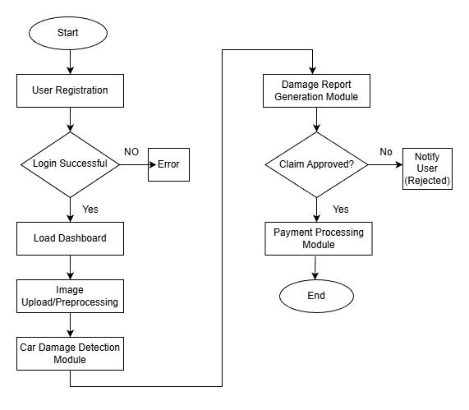
Design Phase
Fig 1.1: Flowchart of Car Damage Detection and Insurance Claim System

Slide 8
Implementation
http://127.0.0.1:5008

Slide 9
Results and Discussion
The system achieved moderate precision (57%), showing reasonable accuracy in identifying actual vehicle damages.
The recall of 49.3% indicates that some real damages were missed, especially minor ones.
An F1-score of 53% reflects balanced but improvable overall performance.
Precision | 57%
Recall | 49.3%
F1-Score | 53%

Slide 10
Conclusion
The system provides a fast and automated solution for car damage assessment and insurance claim processing.
Deep learning models like YOLOv8 help in accurate damage detection, classification, and cost estimation.
Modules for user management, claim submission, payment processing, and admin verification ensure a smooth workflow.
Automation reduces manual work, minimizes errors, and speeds up decision-making.
The system improves efficiency, transparency, and user experience for both customers and insurance providers.

Slide 11
Future Enhancements
Develop a mobile app for claim submission and tracking
Introduce 3D damage analysis for more precise assessment.
Add user feedback loops to improve detection accuracy over time

Slide 12
References
Chaubal, M., Kudai, M. A., Pandere, S., & Champanerkar, K. (2025). Deep learning–based car damage detection for insurance claim settlement. In Proceedings of the 3rd International Conference on Inventive Computing and Informatics (ICICI-2025) (pp. 1645–1646). IEEE.
Lokeswari, P., Kumar, G. K., & Tejaswini, Y. (2025). Automated damage detection and repair cost estimation for automobiles. In Proceedings of the 3rd International Conference on Inventive Computing and Informatics (ICICI-2025) (pp. 1645–1646). IEEE.
Rithik, M., & Chokkalingam, S. P. (2024). Image-based classification for vehicle accident detection and insurance claim using artificial intelligence. In Proceedings of the International Conference on Emerging Systems and Intelligent Computing (ESIC-2024) (pp. 521–528). IEEE.
Gole, S., Gupta, P., Patil, G. S., & Vijayavel, P. (2022). Car damage assessment to automate insurance claim. International Research Journal of Engineering and Technology (IRJET), 9(3), 1811–1814.
G. N., & Arshad, M. A. (2021). Car damage detection using machine learning. International Journal of Advanced Research in Computer and Communication Engineering (IJARCCE), 10(8),725-728.

Slide 13
Thank you

